Slide 1
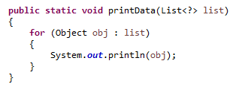
Java Generics Unbounded Wildcard
Sometimes we have a situation where we want our generic method to be working with all types, in this case unbounded wildcard can be used. Its same as using <? extends Object>.
We can provide List<String> or List<Integer> or any other type of Object list argument to the printData method. Similar to upper bound list, we are not allowed to add anything to the list.

